Slide 1
HMS Vision of Learning
Inquiry Based
Learning
21st Century L & I:
Critical Thinking
Creativity
Communication
Collaboration
Strategy Integration
&
Formative Assessment
Interdisciplinary Concepts
Global Trends
&
Events

Slide 2
21st Century Paradigm
Collaboration
Communication
Critical Thinking
&
Creativity

Slide 3
HMS Highlights
Family Math Night
First Lego League
Google Chrome Paperless Classroom
Hispanic Heritage Program
Select Chorus Winter Concert Preview

Slide 4
Family Math Night

Slide 5
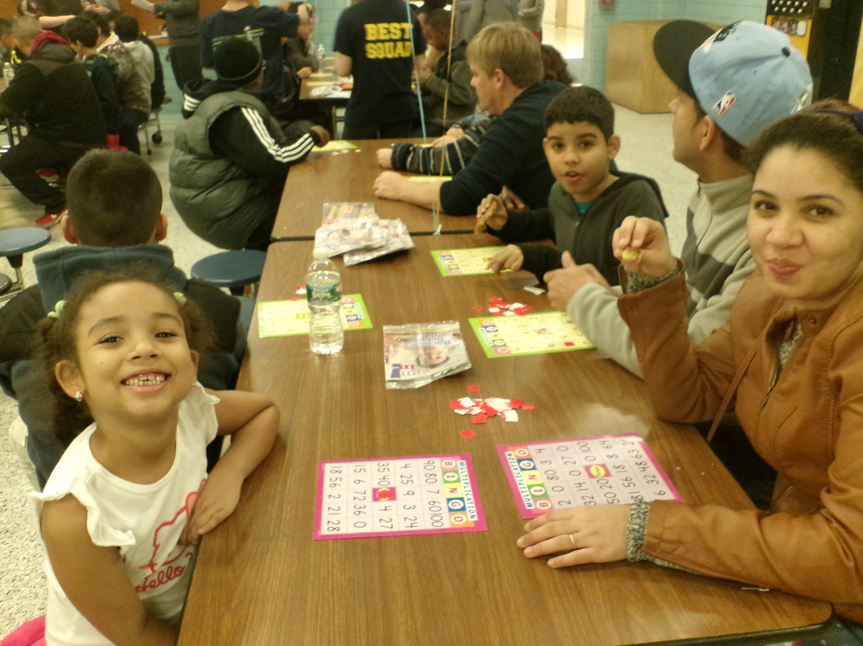

Slide 6
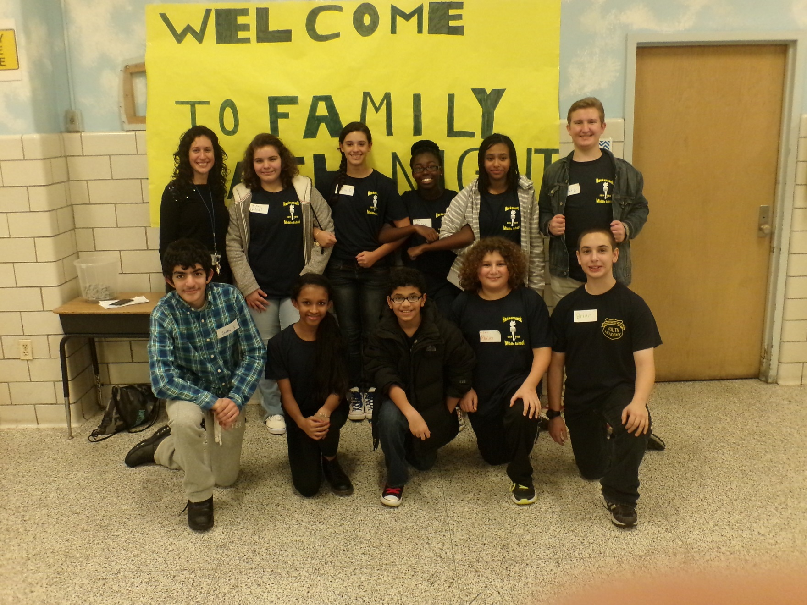

Slide 7
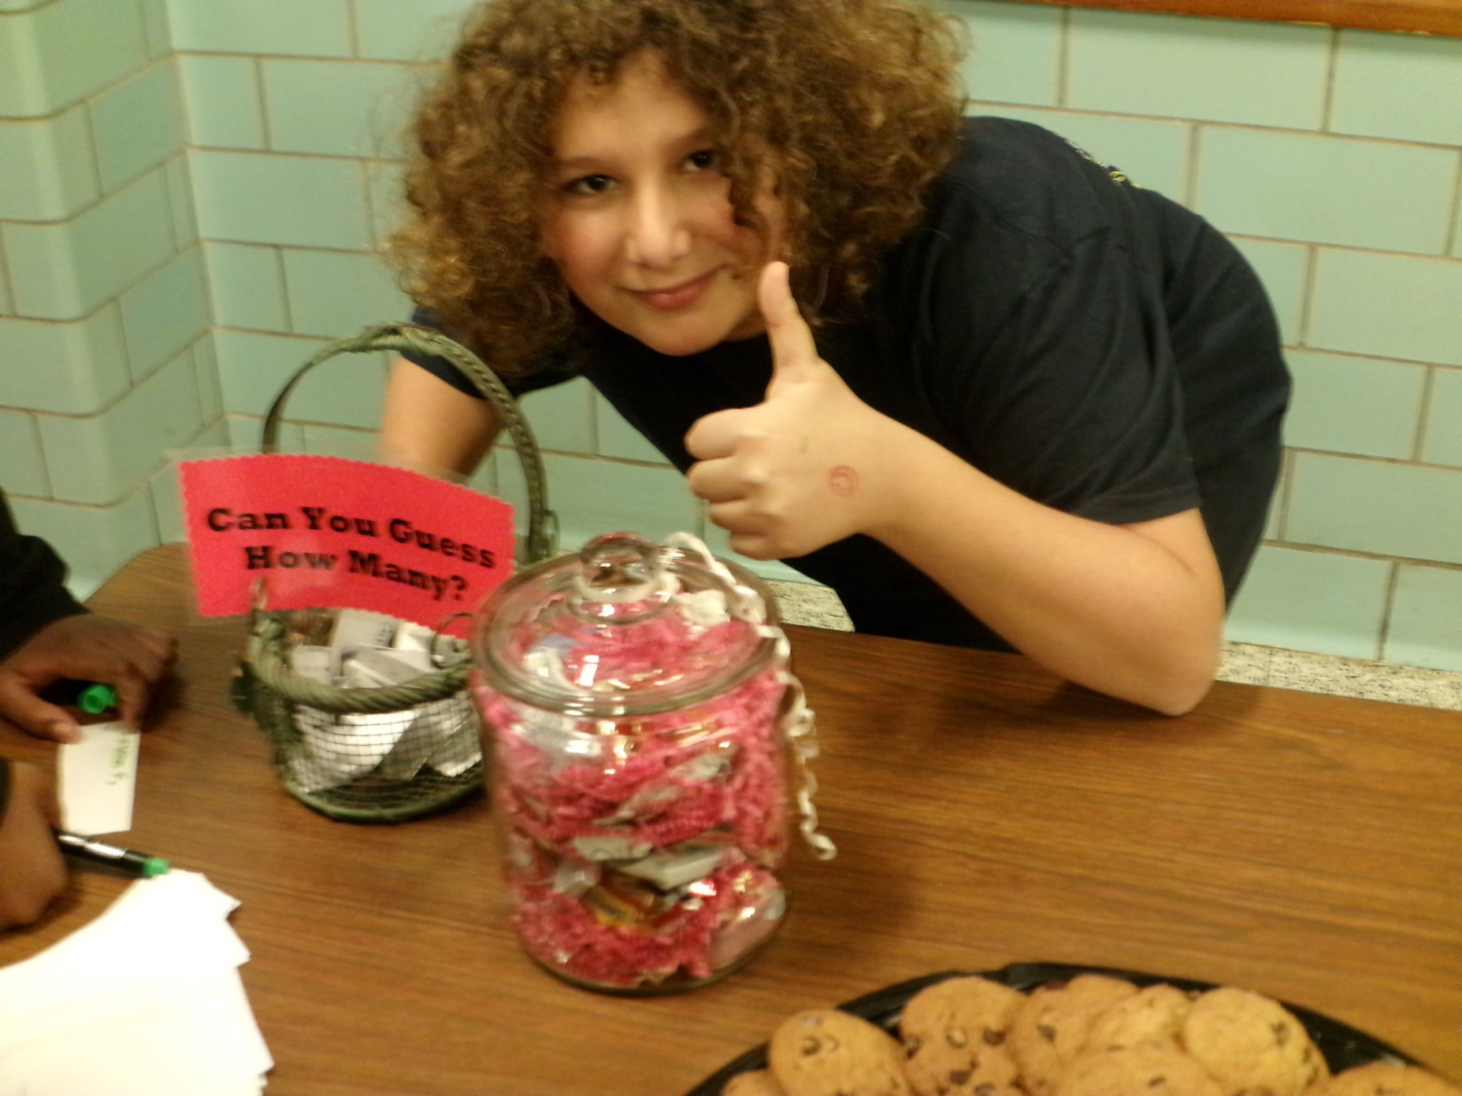

Slide 8
First Lego League Competition

Slide 9
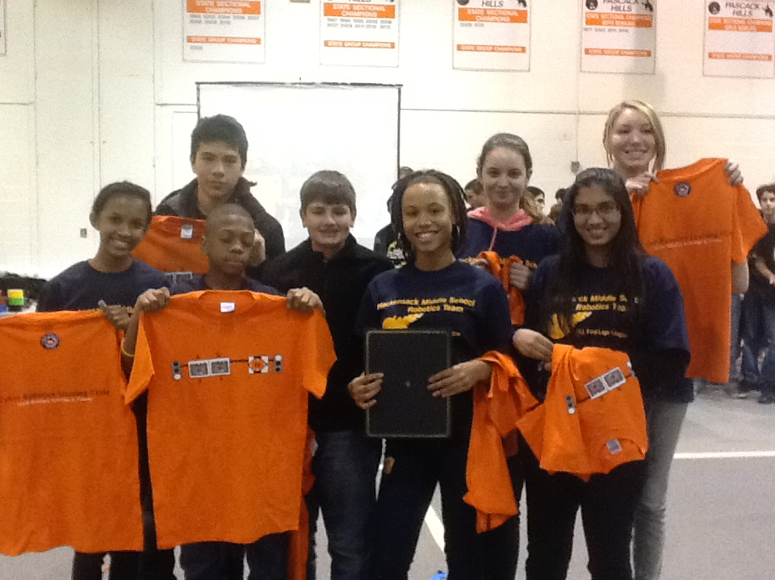

Slide 10
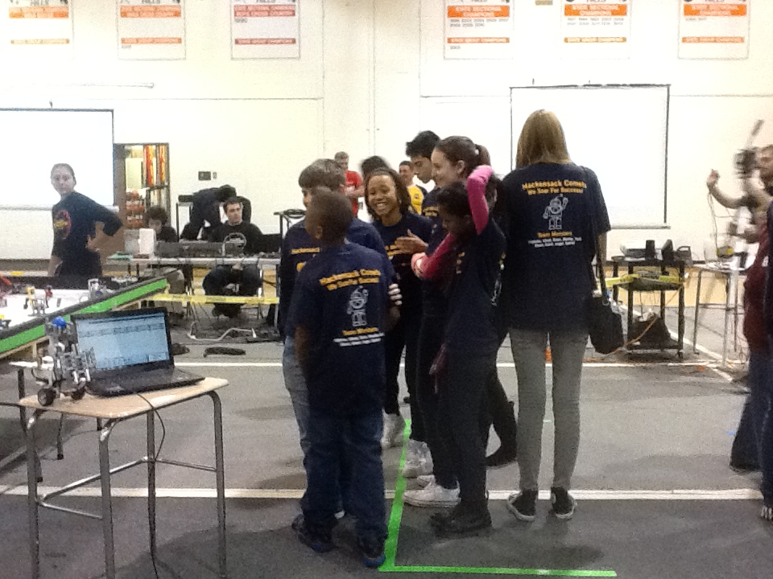

Slide 11
Google Chrome Paperless Classroom

Slide 12
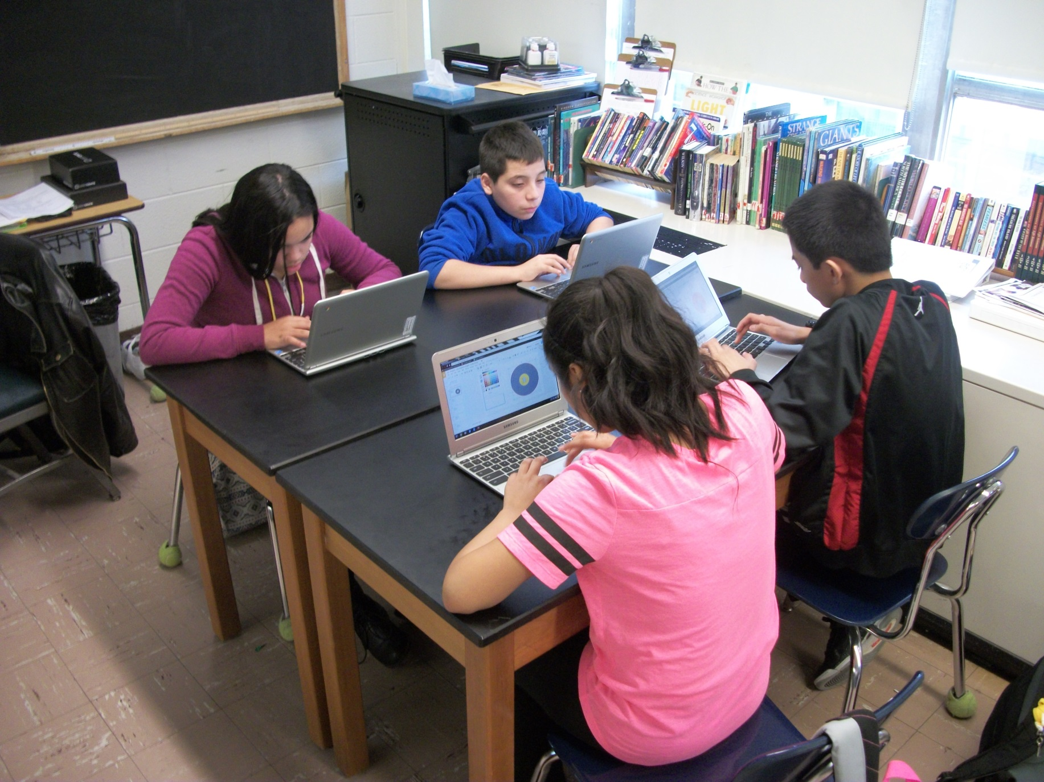

Slide 14
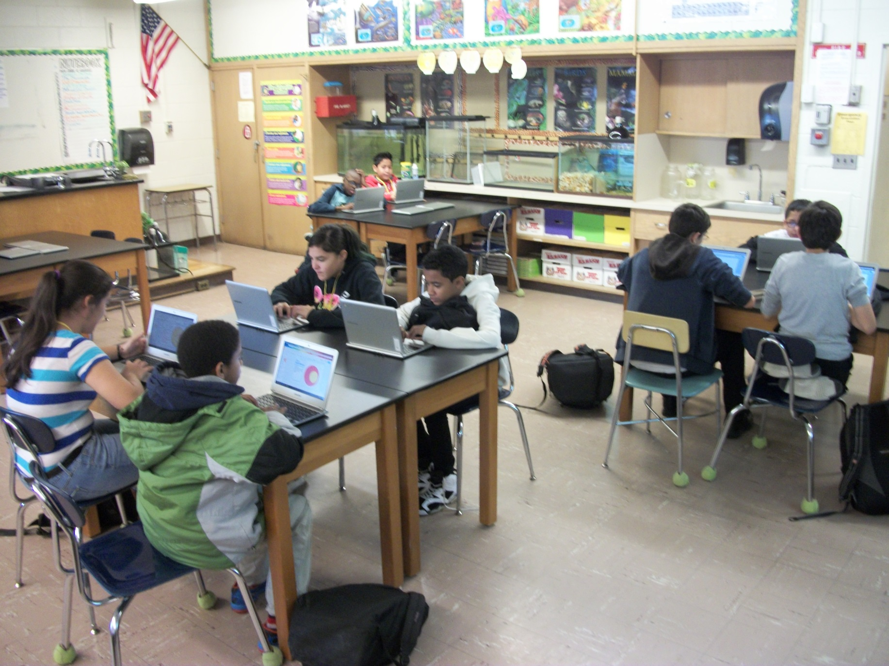

Slide 15
Hispanic Heritage Program

Slide 16
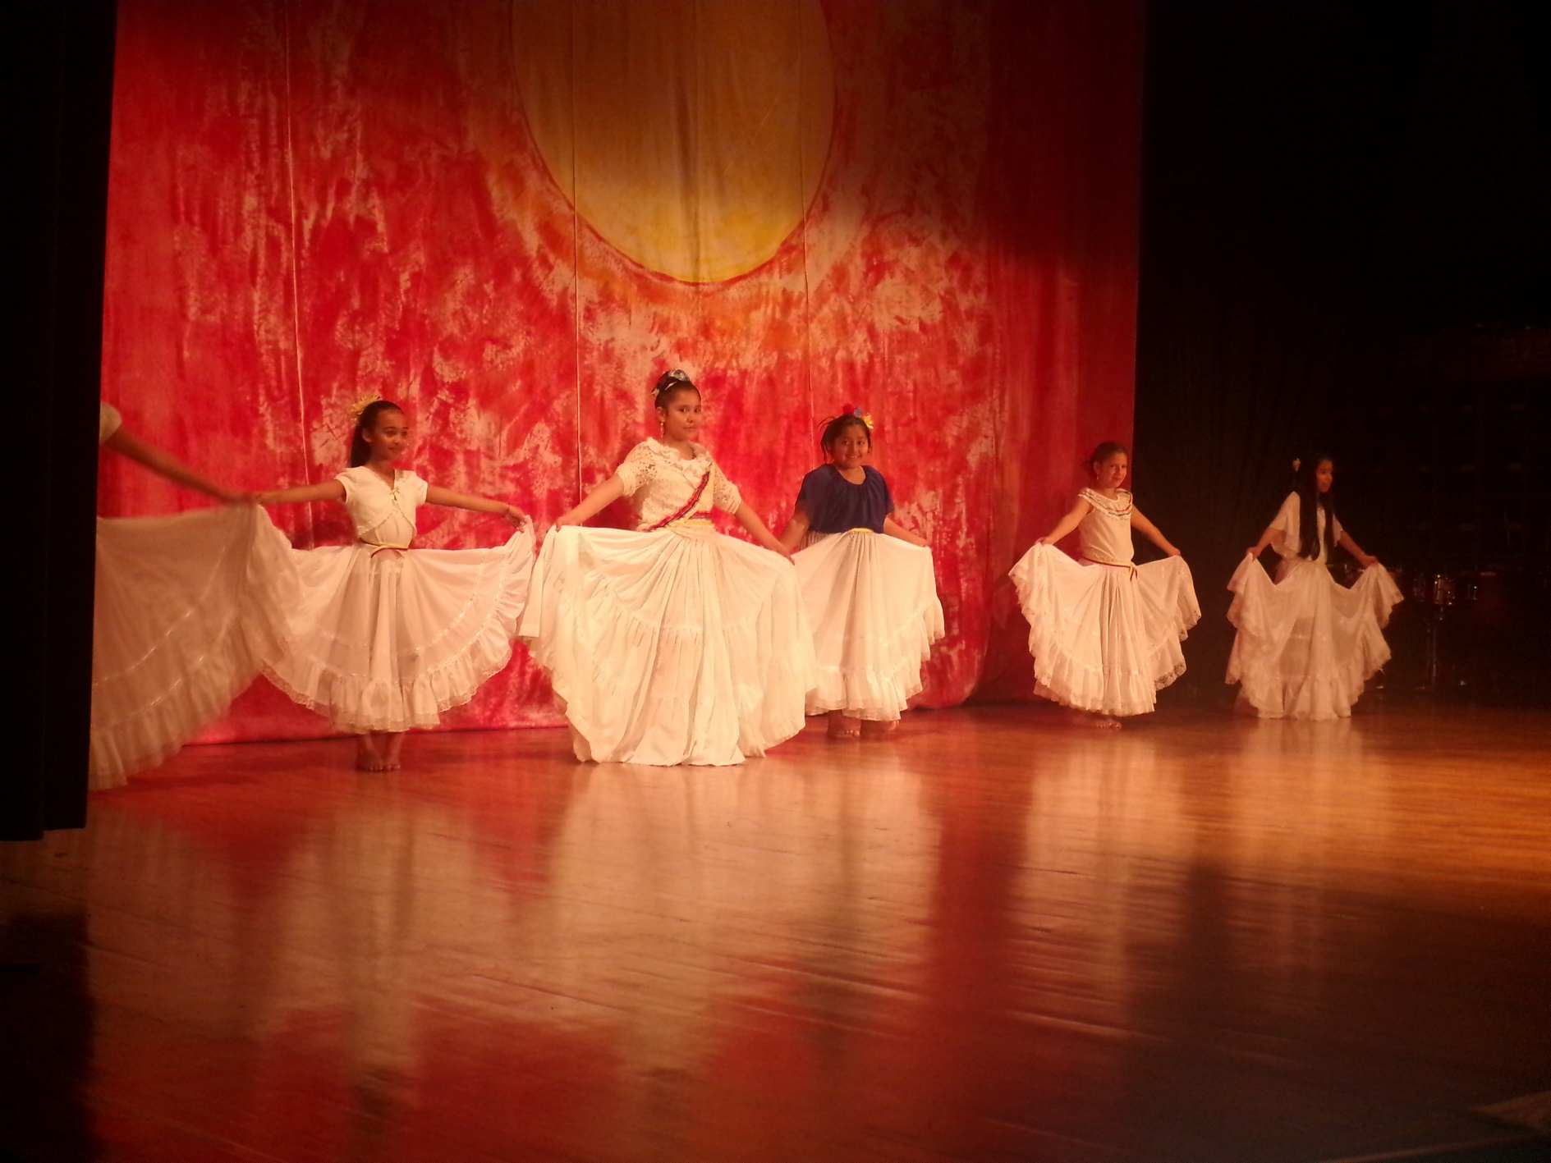

Slide 18
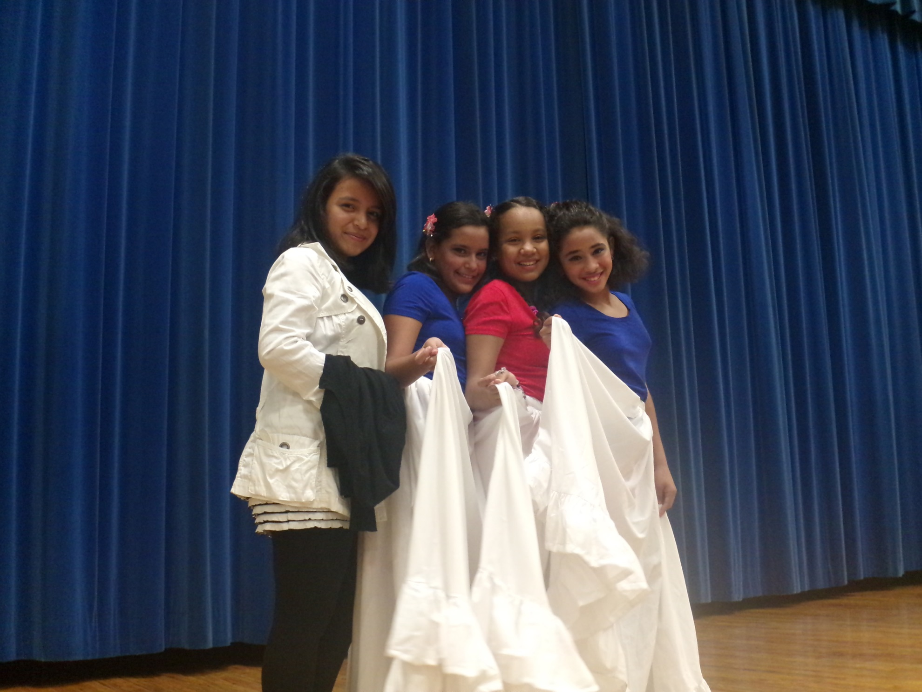

Slide 19
HMS Select Chorus: Winter Concert Preview

